Slide 1
Research Question:
Predicting Blood Donor Availability with Reliability
Guarantees - Split and Mondrian Conformal
Goal
Conformal Prediction
Uncertainty Bounds
Low-Signal Behaviour
Why it matters
Research
Question
Misleading Point Predictions
Valid Coverage
Success criteria
Useful Efficiency
Trustworthy Subgroup Reliability

Slide 2
Dataset Framework
Unit of Analysis
Individual donor records used for
analysis.
Target Variable
Binary classification of donor
availability.
Class Distribution
Balanced distribution of donor
availability.
Feature Categories
Donor profile, donation history,
pints donated
Modelling Challenges
Weak signals, heterogeneity, and
uncertainty.

Slide 3
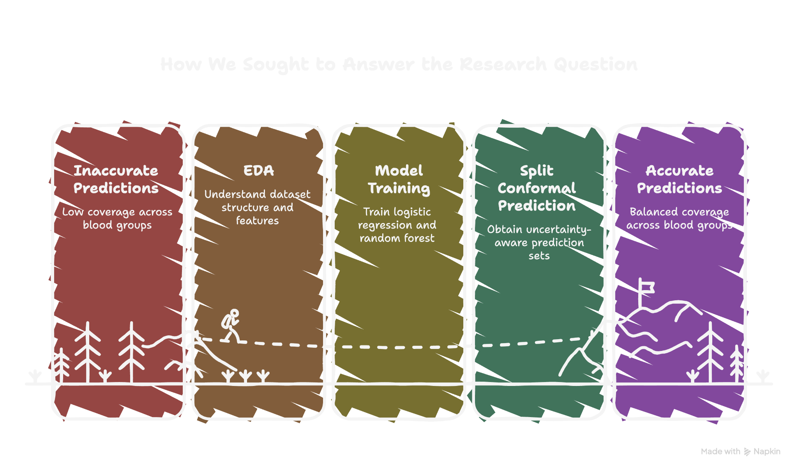

Slide 4
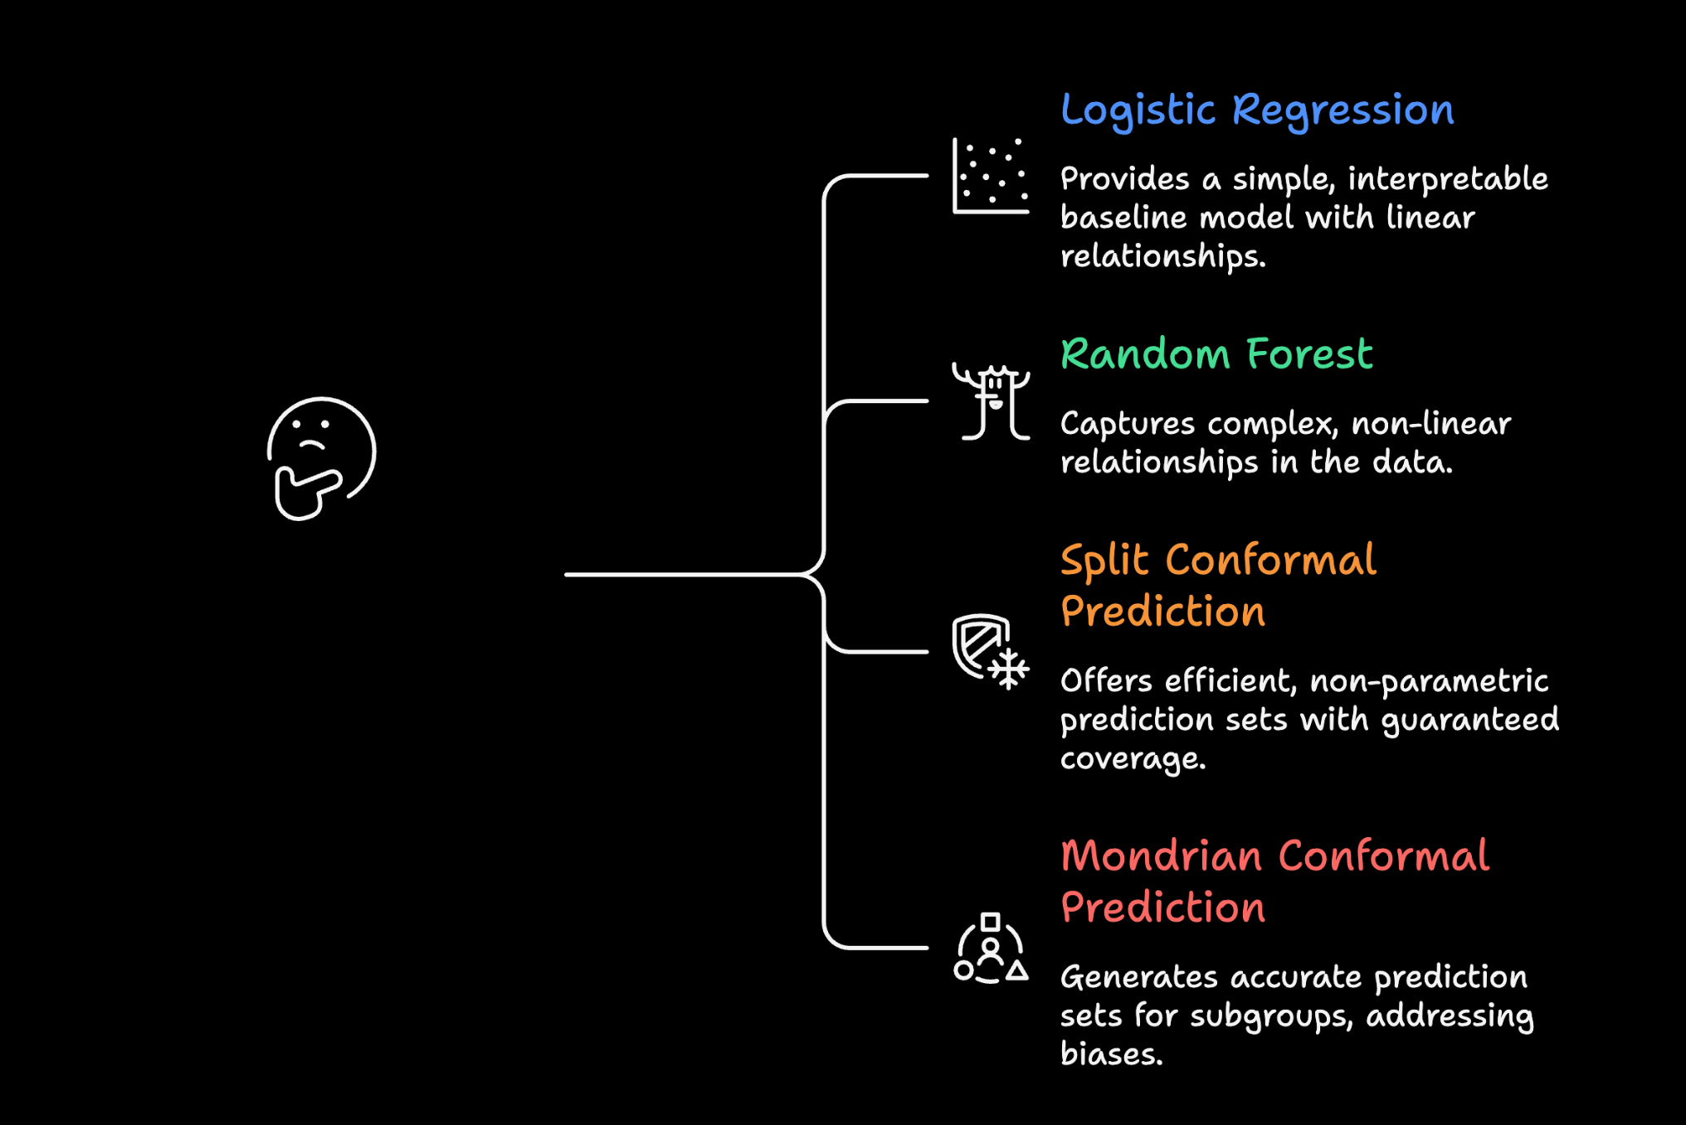
Methods & Why These Methods

Slide 5
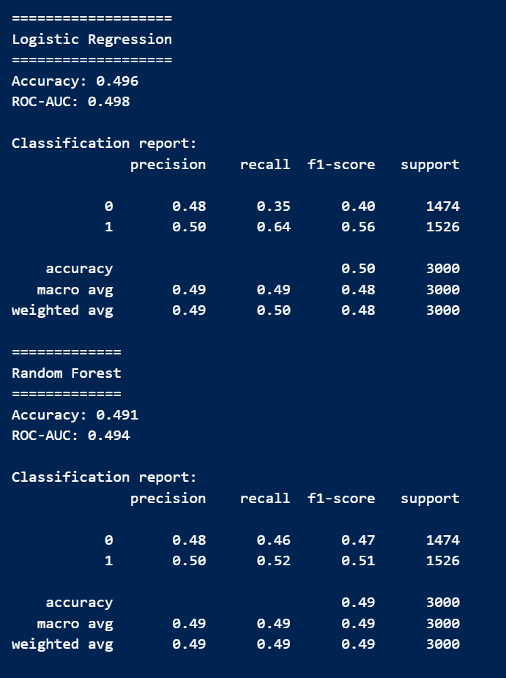
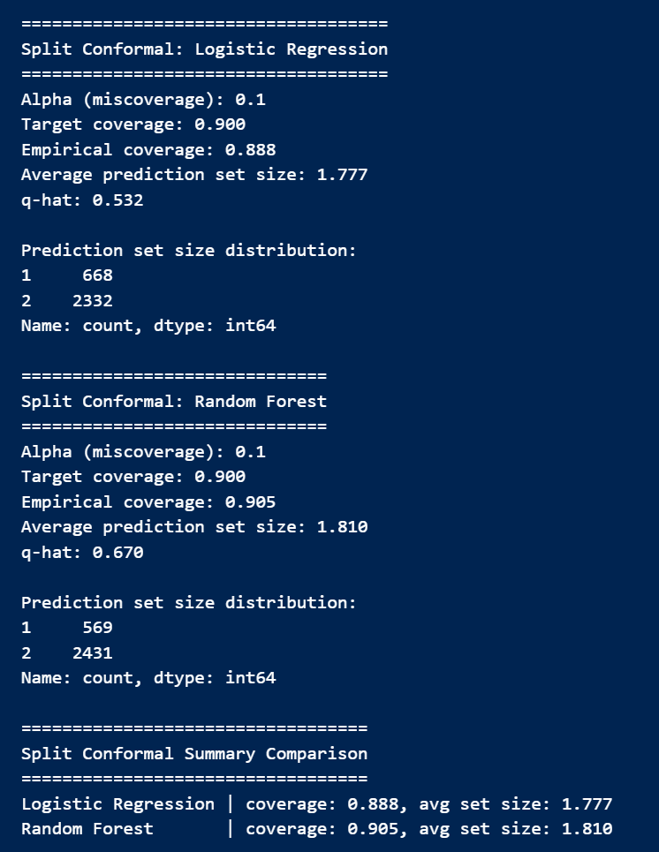
Results & Discussion 1:
Predictive Performance vs Reliability
Near Target
Coverage
Subpar
Accuracy
Calibrated
Uncertainty
Limited Gains
Predictive
Performance
Conformal Validity

Slide 6
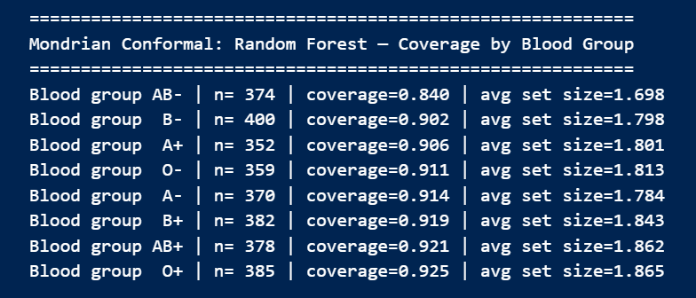
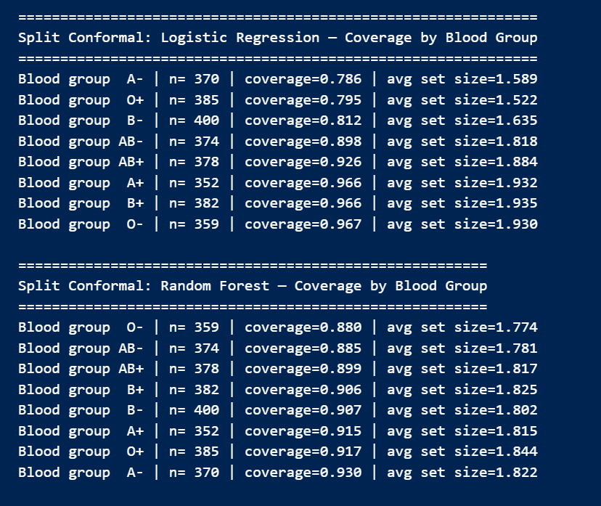
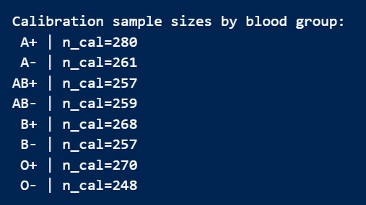
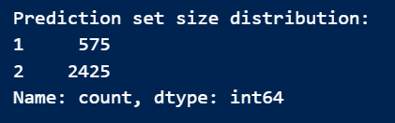
Results & Discussion 2:
Subgroup Reliability [Mondrian CP]
Why subgroup
analysis
matters
Mondrian CP
contribution
Operational
interpretation
High-uncertainty
donors require
contingency
planning, and
prediction sets
guide recruitment,
buffer stock, and
outreach.
Some blood groups
behave differently,
and global
coverage may hide
subgroup under-
coverage.
Improves
alignment of
coverage across
subgroups and
produces more
honest uncertainty
where signal is
weaker.

Slide 7
Limitations
Low Predictive
Signal
Require key real-world
drivers (contextual &
behavioral features)
Exchangeability
Assumption
Real donation
distribution shifts,
weakens prospective
guarantees
Scope of
uncertainty
representation
Focused on binary
classification &
prediction set size as
uncertainty summary
Data Provenance
Uncertainty
Limited documentation,
potential selection bias
Takeaway
Even in low-signal healthcare prediction tasks,
conformal prediction provides grounded reliability guarantees that support more informed decision-making.

